Slide 1

Floral Analytics Stack
Interactive dashboard monitoring units, sales, cost, shrink, waste %, promo uplift, and holiday windows for grocery floral department.

Slide 2

Dataset Foundation
Grain & Span
Scale
Daily by SKU, Jan 2024–Dec 2025
3.6K–4K rows per SKU, 15–20 fields
Key Signals
Price, cost, inventory, waste, promo, holiday flags, weather

Slide 3
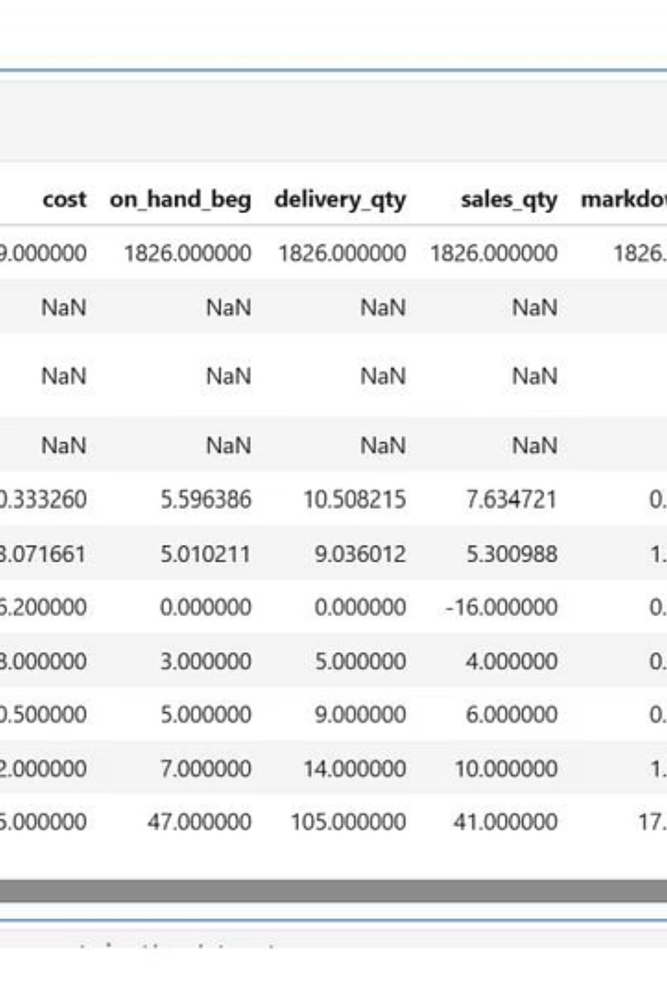
Python EDA: Data Cleaning & Engineering
01
02
Health Checks
Cleaning
Null scan, duplicates, type validation, positive quantities verified.
Clipped erroneous values, harmonized SKUs, forward-filled missing prices.
03
Feature Engineering
Waste rate, gross margin $, promo flags, week ISO, weekend indicators.

Slide 4
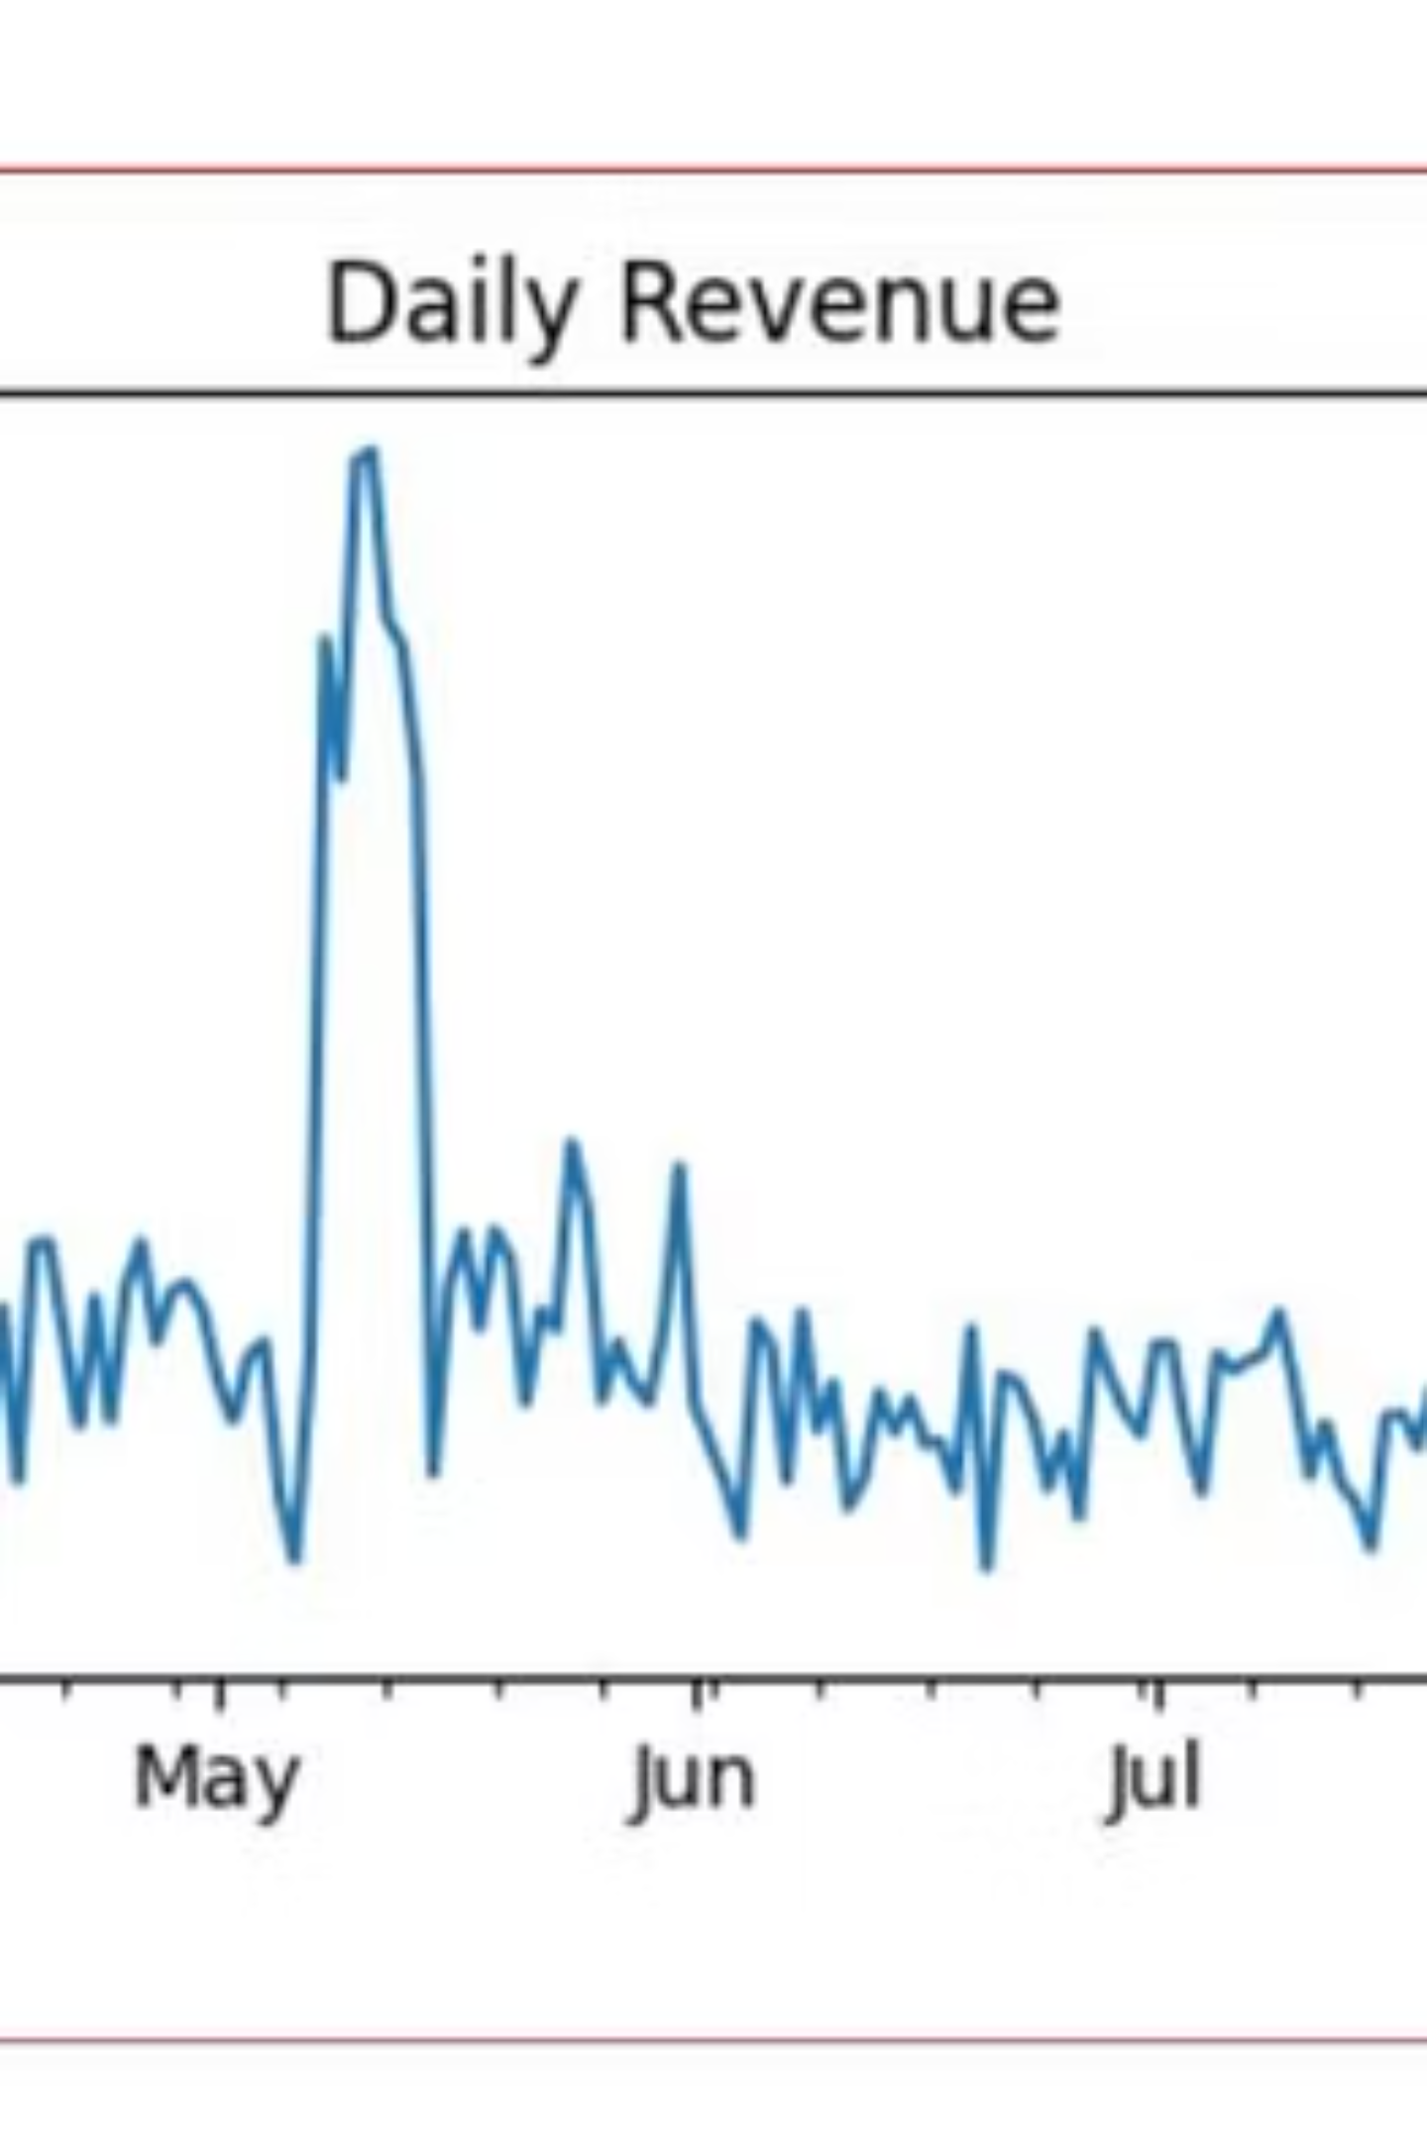
EDA Insights: Holiday & Promo Impact
5-10x
2-2.5x
Inelastic
Holiday Units Spike
Price Lift
Demand Curve
Pricing increases during major holiday windows.
Price-volume largely inelastic during event weeks.
Peak demand during Valentine's, Mother's Day, Thanksgiving, Christmas.

Slide 5
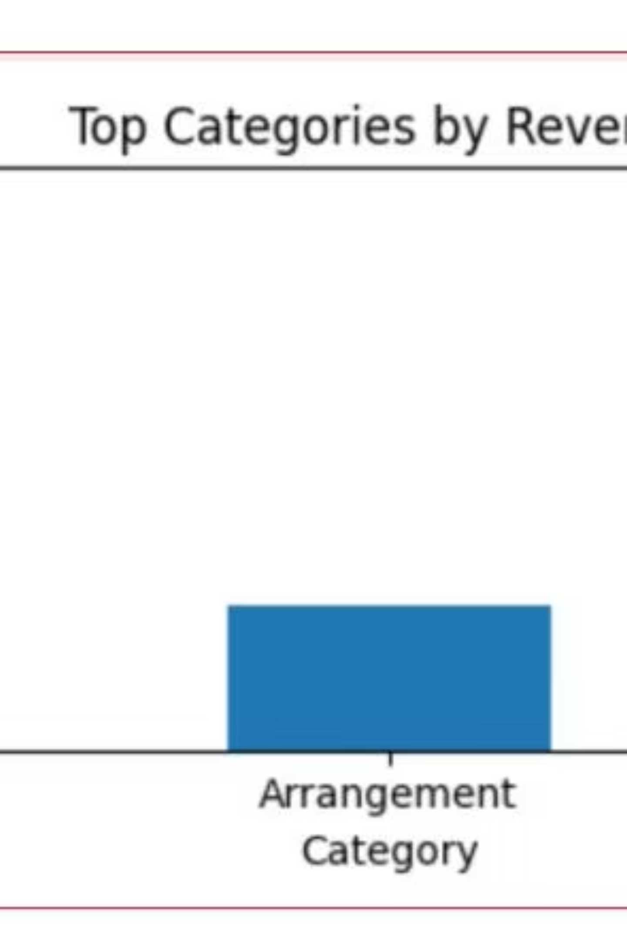
Category Performance Analysis
Bouquets
Plants
Dominate sales and waste $; highest turnover.
Higher unit margin, lower turnover, smaller waste share.

Slide 6
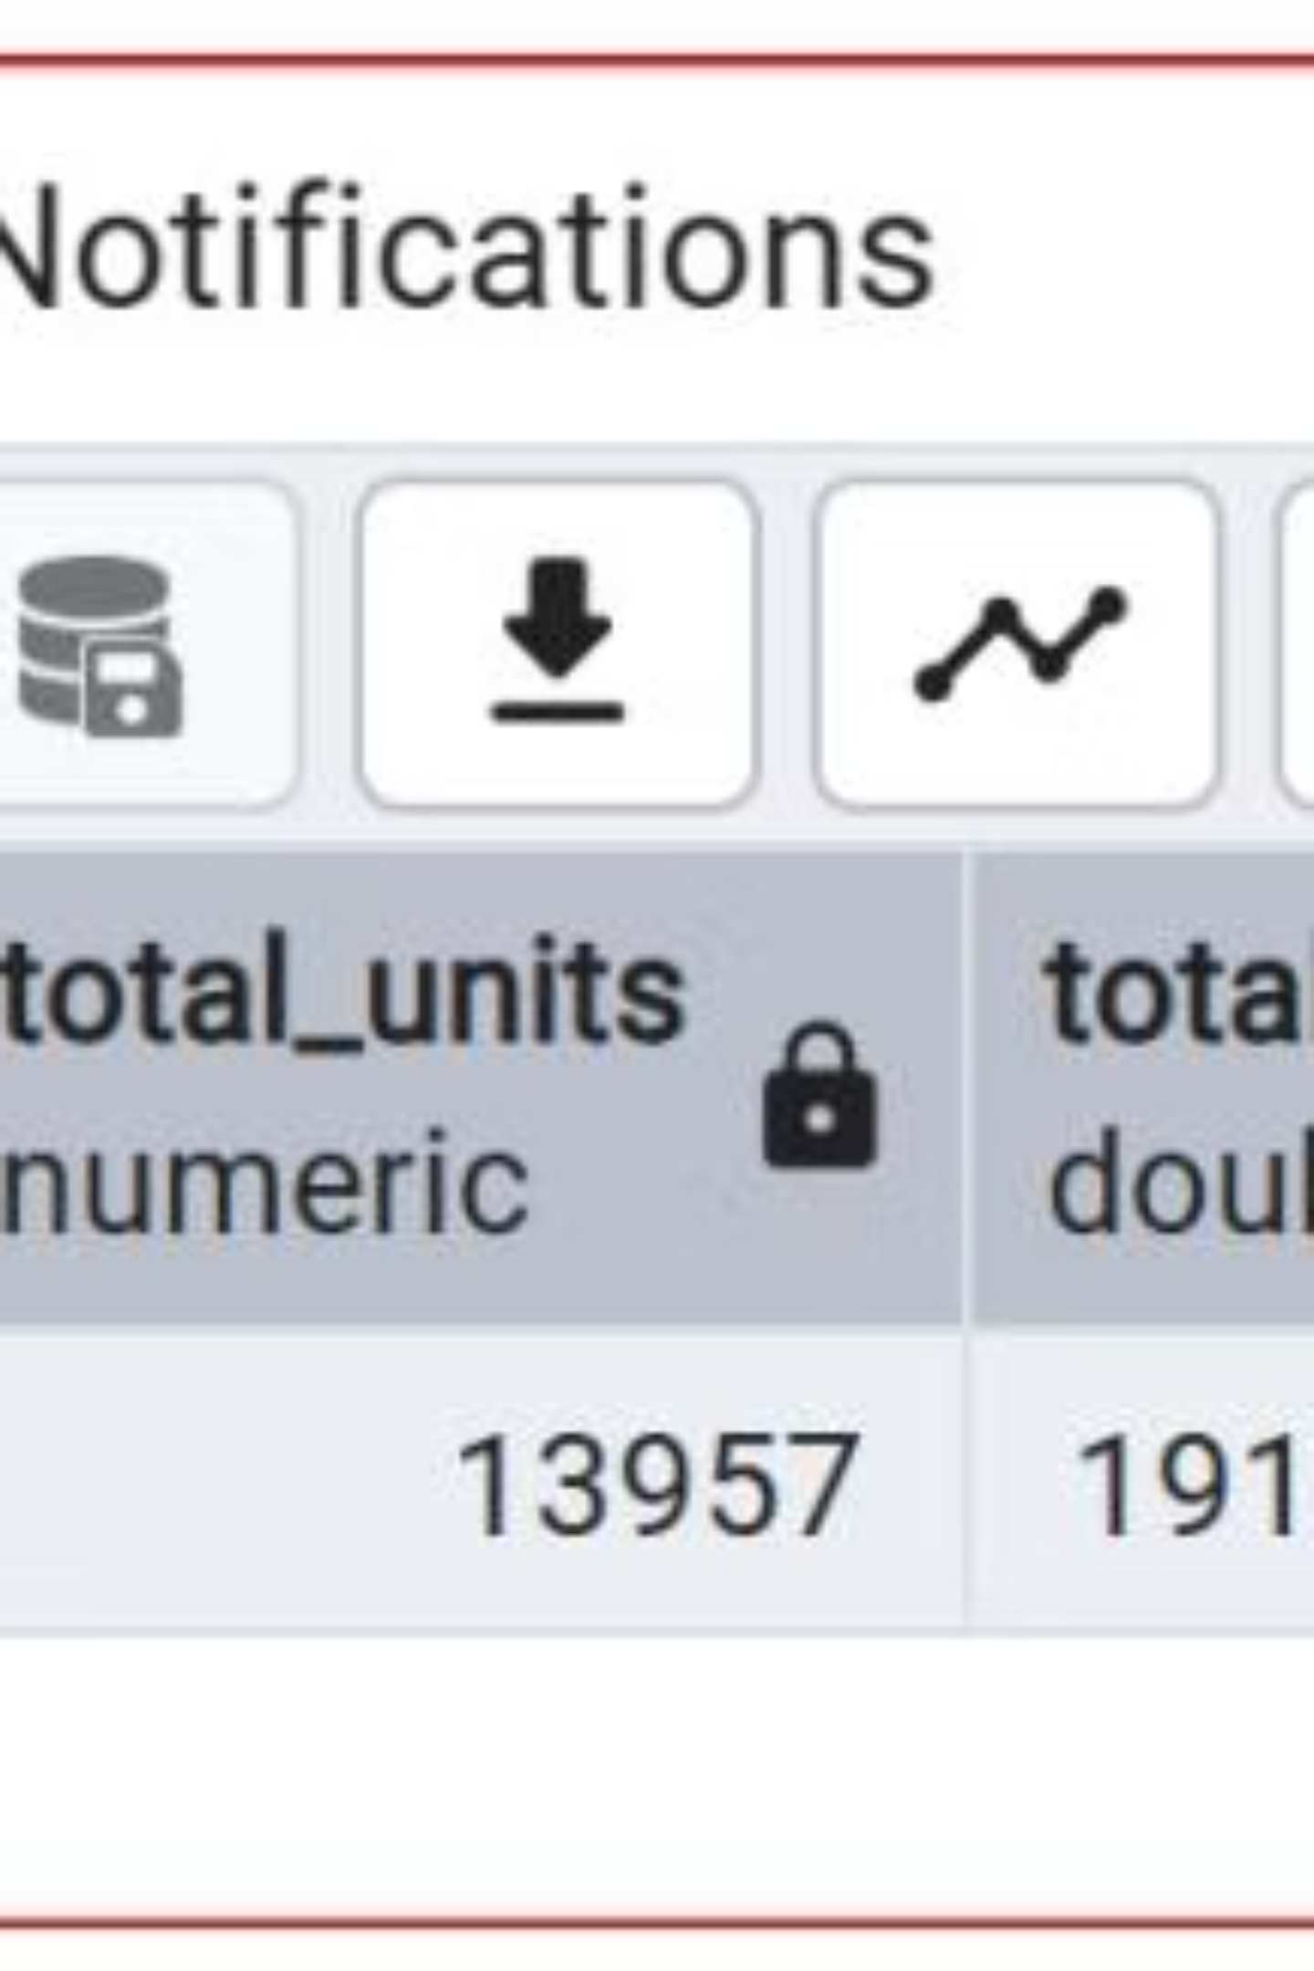
SQL Analysis: Revenue & Margin Trends
Total Revenue, Units, Gross Margin
Aggregate KPIs across two-year span.
Daily Revenue Trend
Seasonal patterns and holiday peaks visible over time.
Top SKUs & Categories
Revenue leaders and margin performance by product.

Slide 7

Operational Metrics: Waste & Markdown
Highest
Variable
Seasonal
Waste Rate
Markdown Rate
Under-Stock Days
Bouquets lead waste $ share; plants lower.
Top SKUs flagged for aggressive discounting.
Peak during holiday windows; varies by SKU.

Slide 8
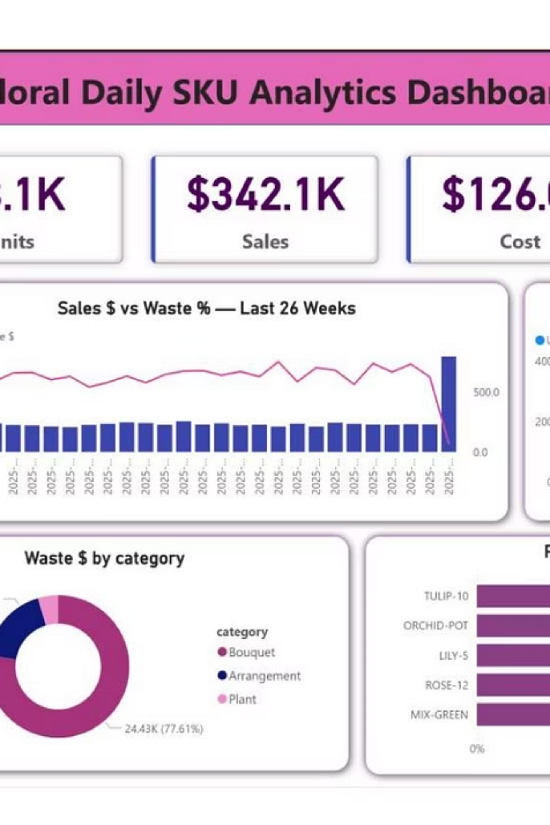
Power BI Dashboard: Real-Time Monitoring
Interactive views with date, holiday, category, and SKU slicers for daily operations.

Slide 9

Strategic Recommendations
Holiday Planning
Waste Control
Promo Targeting
Raise orders 2–2.5× for Valentine's, Mother's Day; enforce post-event markdowns to protect margin.
Focus on Bouquets—pilot tighter delivery cadence and end-of-day markdowns.
Offer top uplift SKUs; avoid deep discounts where demand is inelastic.

Slide 10


Run-the-Business Operations
Weekly Ops Dashboard
Sales vs Waste %
Monitor margin health and shrink trends.
Holiday Window Charts
Track uplift and pricing during peak seasons.
SKU Search Slicer
Quick interventions on underperforming products.

